Slide 1
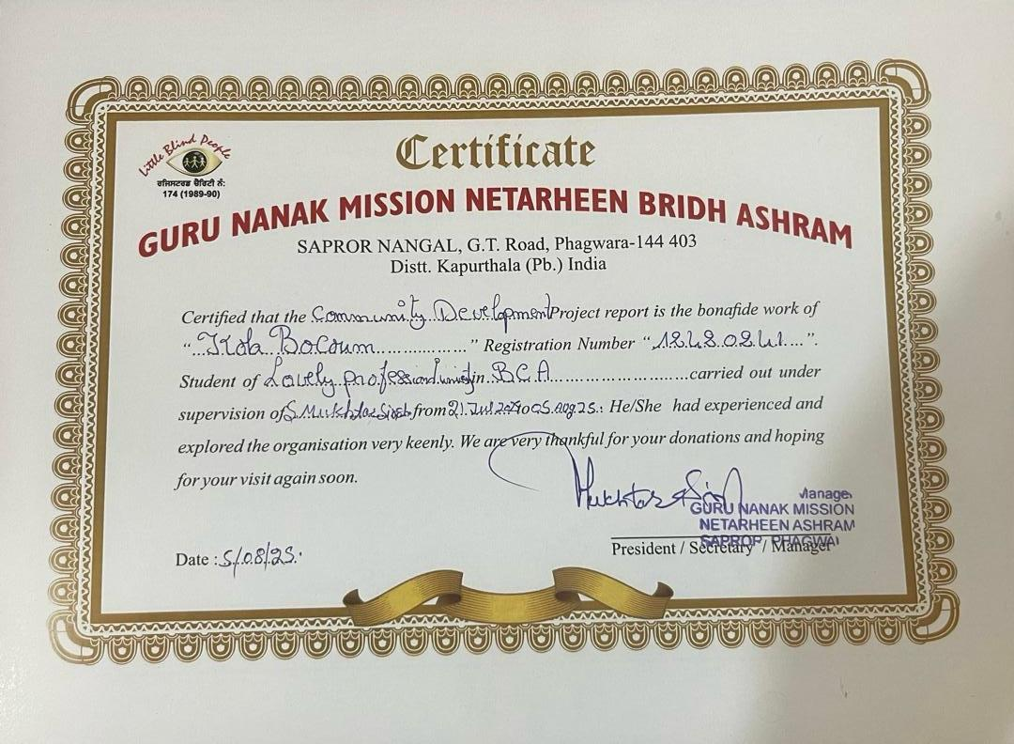
Community Development: Volunteer Service at Guru Nanak Netarheen Bridh Ashram
This report documents the problems and underlying causes observed during volunteer service at Guru Nanak Netarheen Bridh Ashram, the set objectives for the volunteer project, the meticulous steps that should be undertaken to realize these objectives, and a comprehensive evaluation of the project's overall effectiveness.
by Kola Bocoum
By BOCOUM

Slide 2
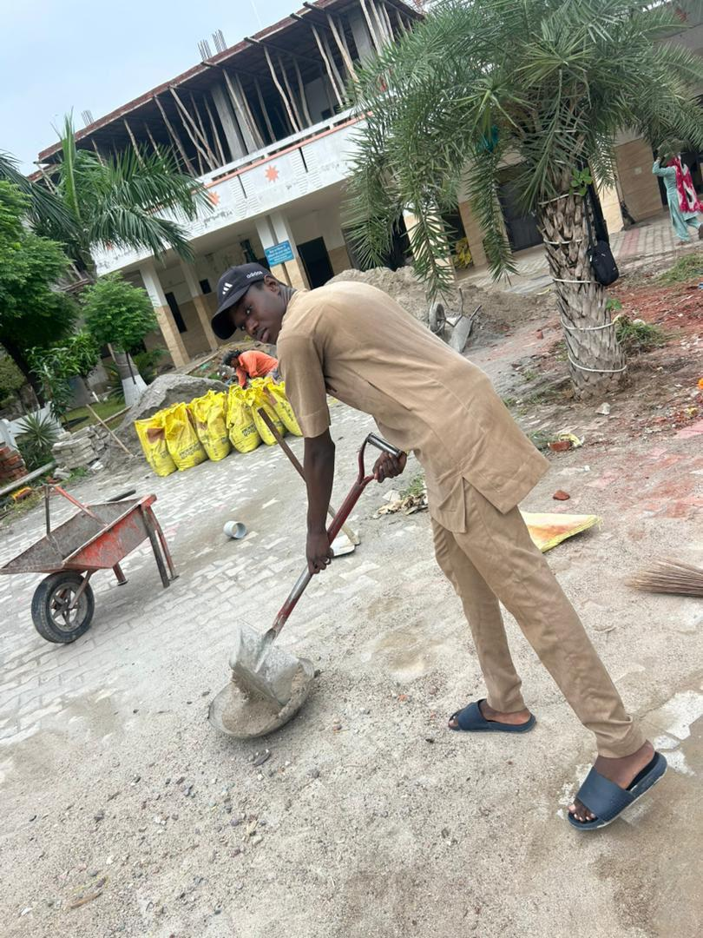
Problems and Causes
1
Lack of Accessibility
The physical infrastructure of GURU NANAK is not adequately adapted to cater to the unique needs of visually impaired residents.
2
Social Isolation
Many residents expressed a sense of social isolation, stemming from the absence of inclusive activities and opportunities for communal interaction.
3
Emotional Well-Being
A significant number of residents display signs of emotional distress, loneliness, and even depression, which were exacerbated by their visual impairment and the resultant limitations.
By BOCOUM

Slide 3
Objectives To Be Achieved
Enhance Accessibility
Foster Social Inclusion
Improve Emotional Well-Being
Implement modifications to the physical environment to create a seamlessly accessible and navigable space for the visually impaired residents.
Devise and execute a range of activities and events that actively encourage social interaction, engagement, and a sense of community among the residents.
Develop and implement targeted strategies to address the emotional wellbeing of the residents, providing them with necessary support and companionship.
By BOCOUM

Slide 4
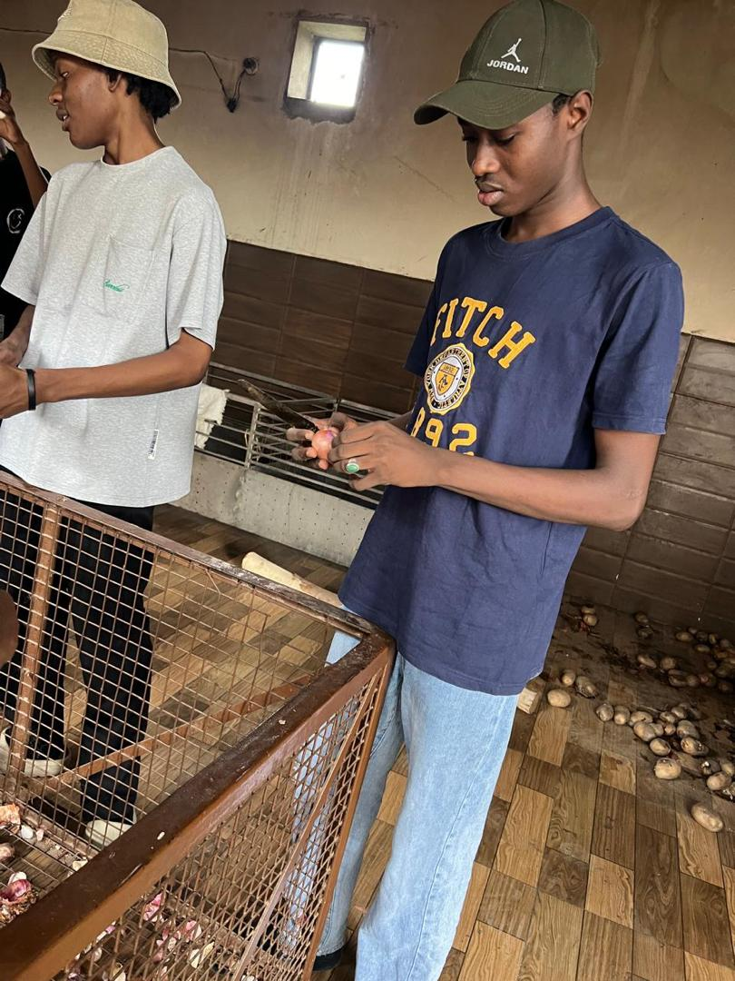
Steps To be Taken
1
Physical Adaptations
Collaborate with skilled local contractors and volunteers to introduce a range of physical adaptations.
2
Activity Planning
Implement diverse and engaging activity calendar that include regular group music sessions, tactile art classes, and storytelling circles.
3
Counselling Services
Partnered with mental health professionals to establish regular counselling sessions and support groups specifically tailored to address the emotional needs of the residents.
4
Training And Education
Conduct comprehensive workshops for both GURU NANAK staff and volunteers to sensitize them about interacting effectively with visually impaired individuals.
By BOCOUM

Slide 5
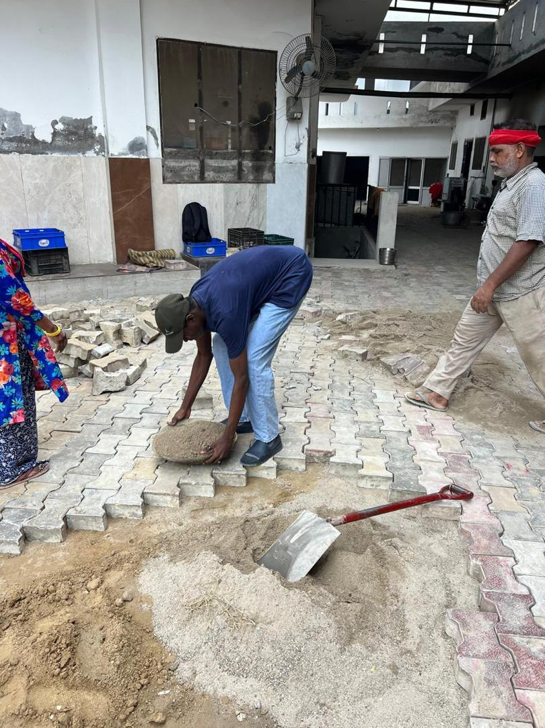
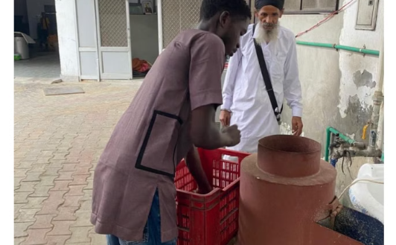
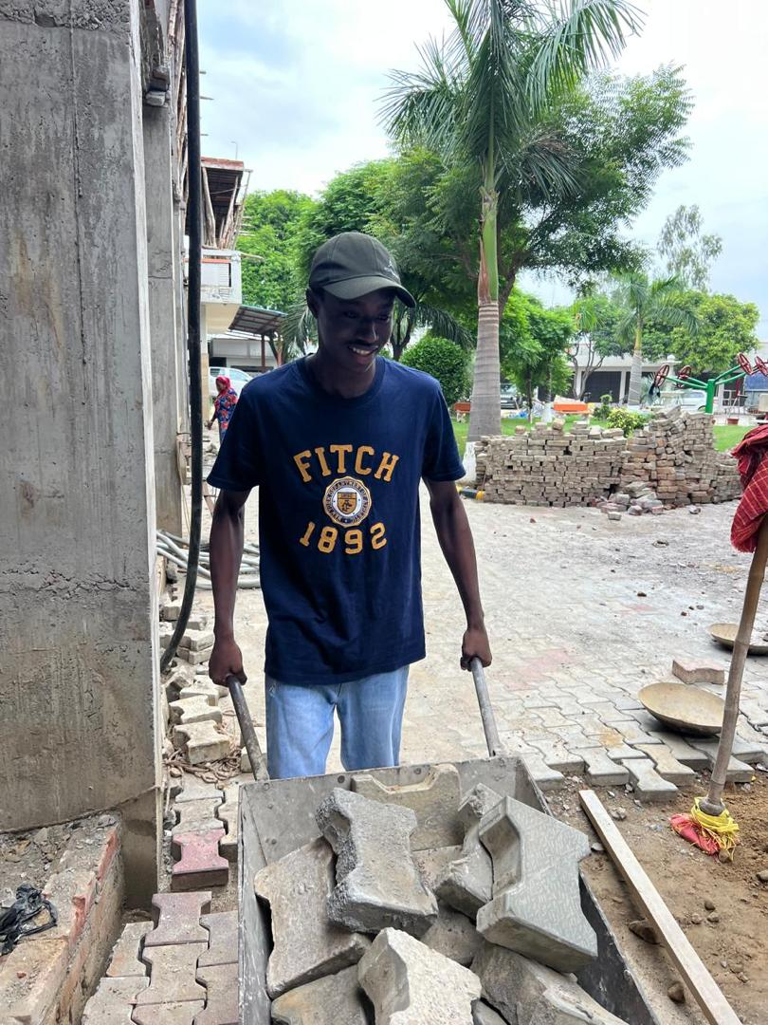
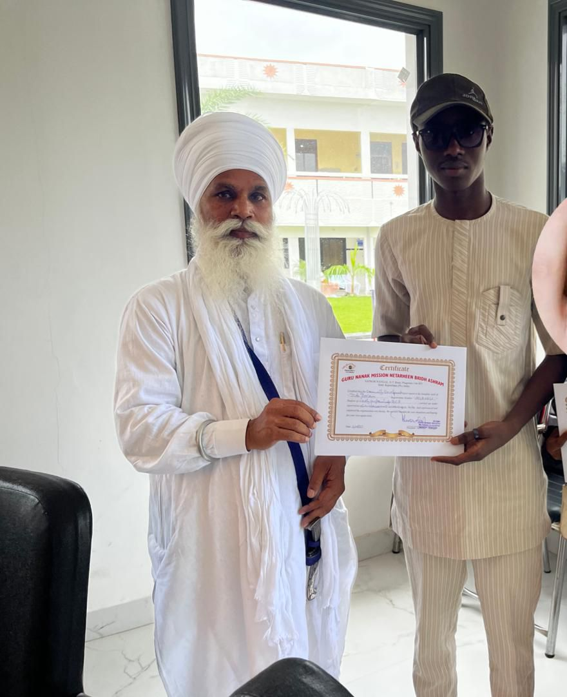
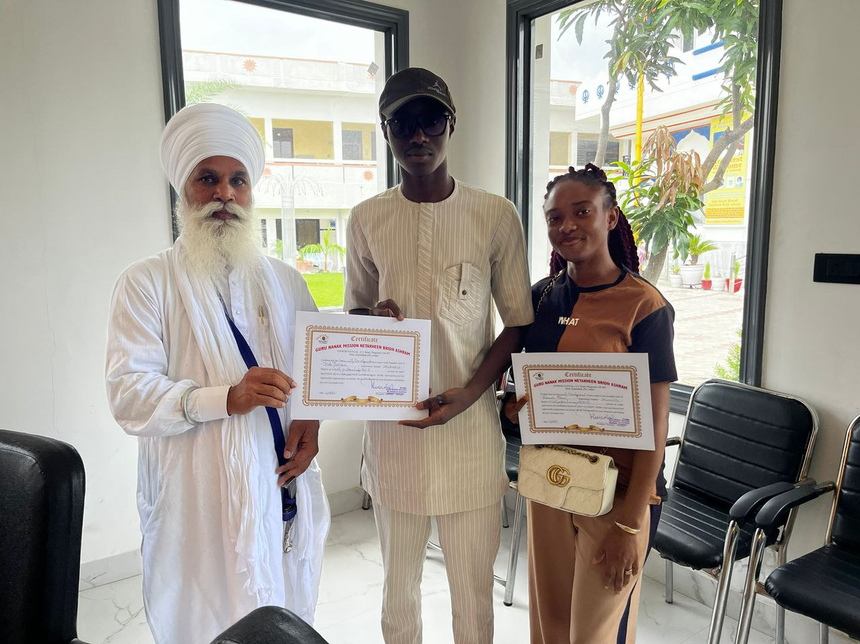
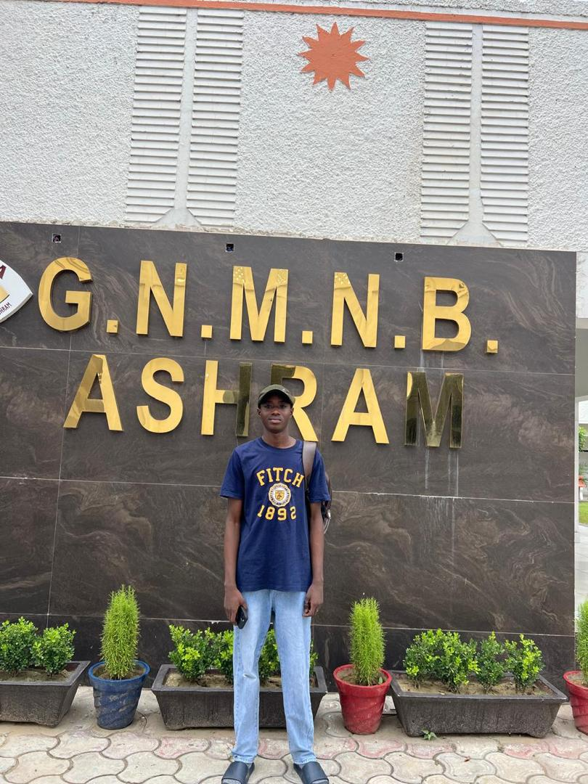
Geo Tagged Pictures

Slide 6
Effectiveness Of The Project
Improve Accessibility
Increase Social Interaction
Enhance Emotional Well-Being
Introduce physical adaptations led to a noticeable improvement in the residents' ability to navigate inside the ashram independently and safely.
Introduce activities and events that will successfully prompt residents to participate more actively.
Establish regular counselling sessions and support groups that will serve as valuable platforms for residents to express their emotions.
By BOCOUM

Slide 7
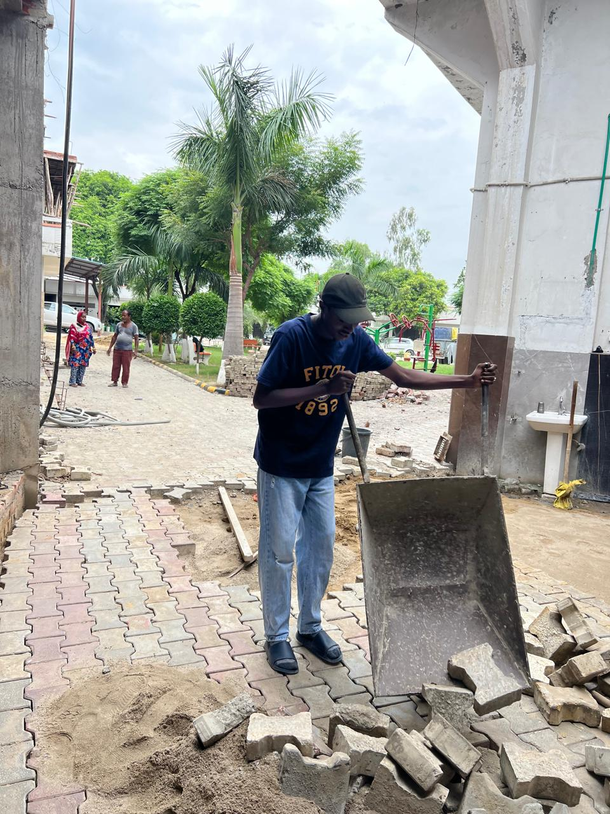


Two (2) Identified Societal Problems
Falls And Injuries
Visual impairment significantly increases the risk of falls and injuries among older adults.
Accessibility And Healthcare Challenges
Visually impaired elderly individuals face unique challenges related to accessibility, navigator barriers, poverty, and healthcare utility.

Slide 8
Conclusion
The volunteer service at Guru Nanak Netarheen Bridh Ashram yielded remarkable outcomes by directly addressing the identified issues of accessibility, social inclusion, and emotional well-being. The positive feedback from all stakeholders underscores the effectiveness of the project, and the continuity of efforts ensures the perpetuation of these positive changes in the lives of the visually impaired elderly residents.
By BOCOUM

